Slide 1
Thoughts on Remote Identity Proofing
Jim Fenton

Slide 2
A Recent Experience
Healthcare provider (testing lab)
Email invitation to new online service to retrieve test results
Remote identity proofing (5 choices each):
  Former address
  Former employer
  First two digits of SSN

Slide 3
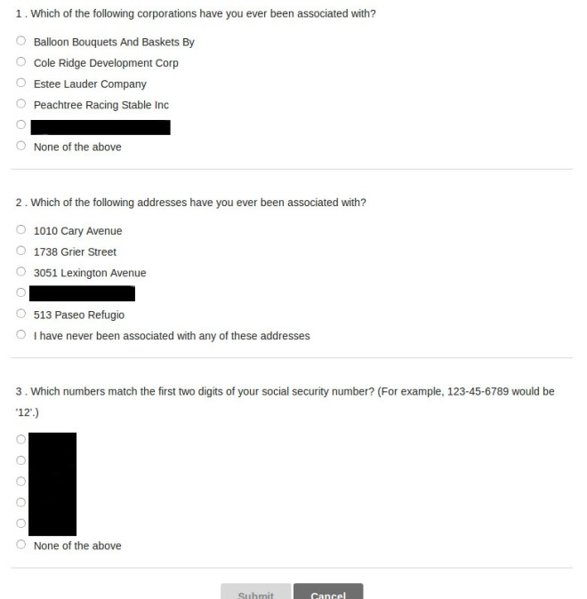

Slide 4
What could they have done?
Tie online interaction with in-person visit
  Give me a key (even printed) during visit
  My doctor did this
Tie online interaction with email
  Customized link containing a token
  But their email token was used only for analytics

Slide 5
Was remote identity proofing really needed?
The real objective was to associate an online interaction with an in-person event
Why link these through identity proofing?

Slide 6
The Future?
Patient authenticates using token at point of service
Uses same token to authenticate for online access
Much better user experience!

Slide 7
Threat Analysis
Who are the attackers?
What are they trying to accomplish?
What are their capabilities?

Slide 8


Attackers
Outsiders
Insiders
Who:
  Scammers (financial motive)
  Trolls (reputation motive)
Tools:
  Data from social networks
  Social engineering skills
Who:
  Former business associates
  Ex-spouses
Tools:
  Personal knowledge of target

Slide 9
Attack goals
Outsiders
Insiders
Akin to phishing
  Obtain an identity to use for employment, etc.
  File bogus tax return to collect refund
Akin to spear phishing
  Compromise specific individual
  Obtain private information
  Perform transaction on target’s behalf

