Slide 1



Open Payments Innovation in Latin America
Kim Hangoc, VP Emerging Payments
Smart Card Alliance Member Meeting – Oct. 2015

Slide 2
Agenda
Status of EMV and Contactless migration in LAC
Open Payment Innovations: beyond traditional payment
Case Studies:
  Transit: Recaudo Bogota and São Paulo
  Social Card:
    First Russian Social Card
    South African Social Security Agency (SASSA) program
Conclusion

Slide 3
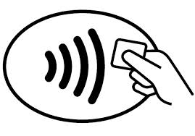
EMV Migration Status – H1-2015
EMV Cards
Penetration Rate: 77%
EMV POS
Penetration Rate: +90%
EMV ATMs
Penetration Rate: +66%
34 markets
with chip deployment
Contactless:
Strong development of contactless in the recent years
10 markets with contactless deployment
  Mexico, Brazil, Colombia, Chile, Bermuda, Panama, Costa Rica, Honduras, Nicaragua, El Salvador,
Brazil has the largest Contactless POS base in the world
All cards issued are EMV based (except for Bermuda)
Country with massive chip deployment
Country starting chip deployment
Country with contactless deployment

Slide 4
LAC Migration characteristics
47 markets in the region
The majority of countries use “Chip & PIN” cards but some markets have chosen “Chip & Signature” (such as with credit cards in Mexico)
~100% of transactions are authorized online
Majority of issuers progressively switching from “partial grade” mode to “full Grade”
Almost all cards use SDA (Static Data Authentication) but banks preparing actively SDA Sunset
M/Chip 4 is the most common payment application although some portfolios of M/Chip 2.1 cards still exist in Brazil and Mexico. M/Chip Advance in phase of expansion in LAC.

Slide 5
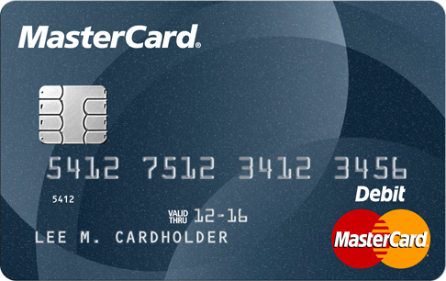

Open Payments Innovation: beyond traditional payment …
FEATURES
APPLICATIONS
Simple and Secure: Chip & PIN experience
Pre-paid cards
WW acceptance infrastructure
Subsidies / Government Program
Offline Risk Management capabilities
Transit
Contactless Capabilities
ID / Authentication
Possibility to add biometrics
Social Card

Slide 6
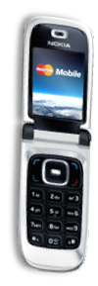
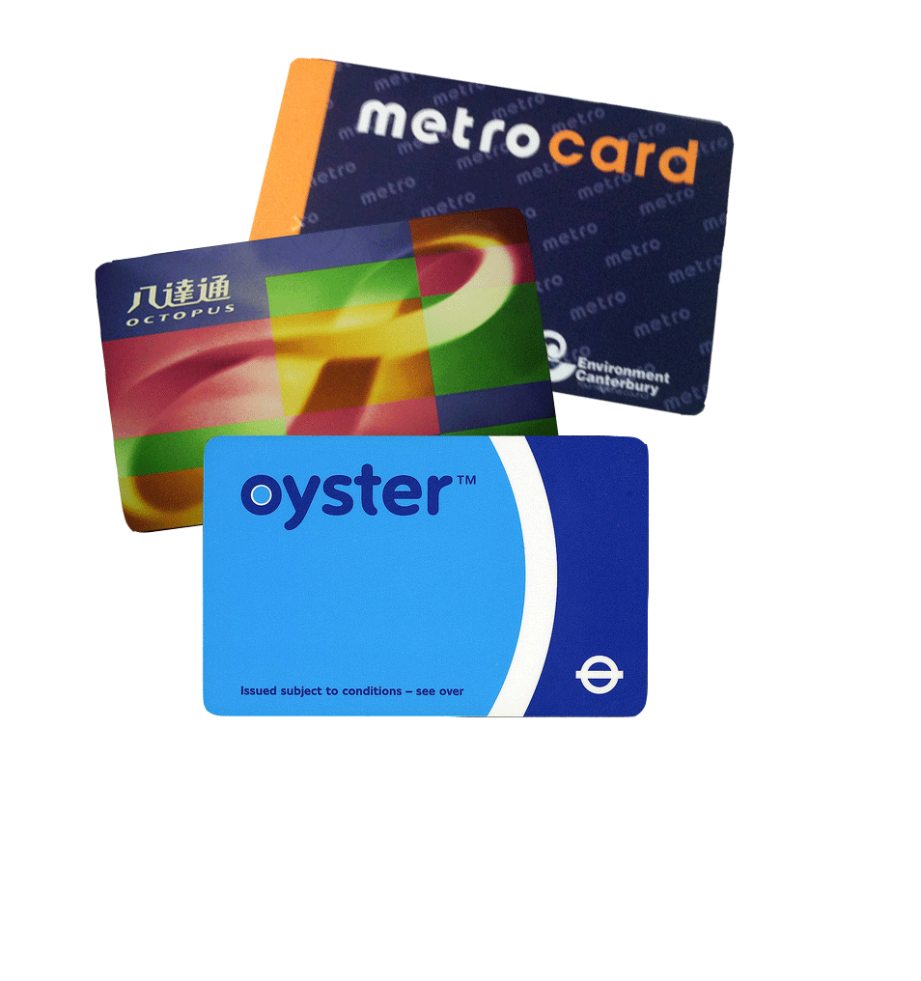
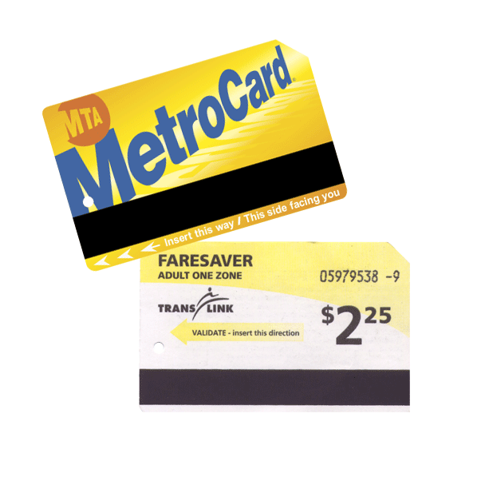
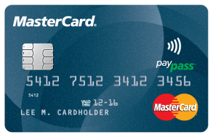
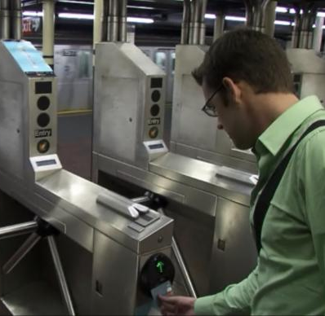
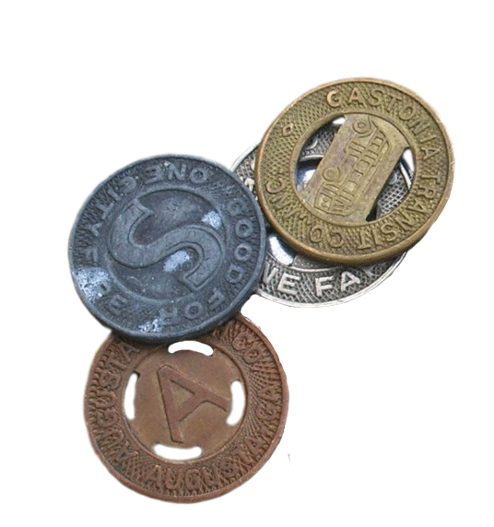
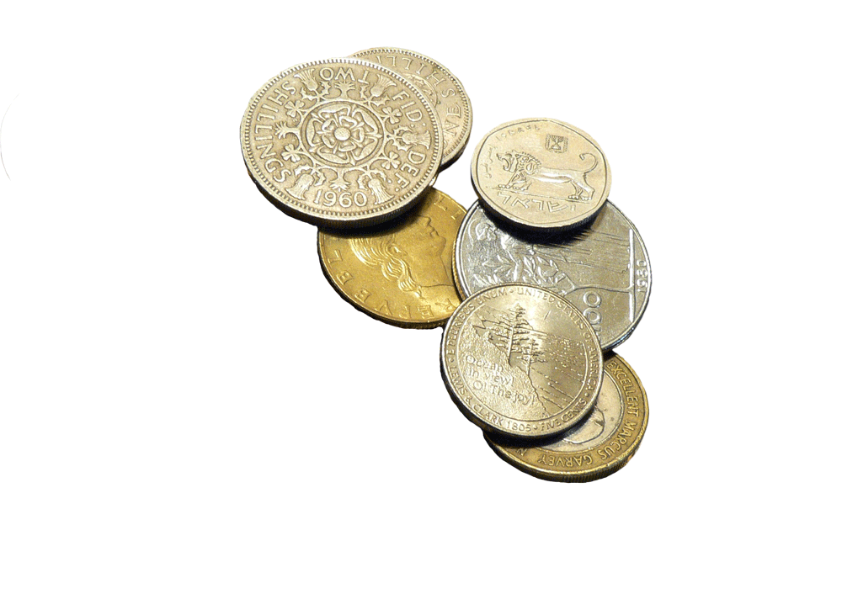

Evolution of Mass Transit Fare Payment
TICKETING SOLUTIONS
OPEN PAYMENTS
Smart Cards
Tap to Ride
Coins
Magnetic Stripe
Contactless Cards & Devices (open)
Tokens
TODAY
TRIAL
GOAL
110+ YEARS
Source: Greg Garback, WMATA, CardTech SecurTech Briefing, May 2007
Notes:
Over the past century, fare payment has evolved from early use of ordinary currency, to tokens, to magnetic stripes.
At every step, transit agencies have benefited from the advance of technology:
Increasing the speed of payment
And ultimately the capacity to move more and more people through complex transit systems.
Today, contactless technology is taking hold. However, the predominant delivery system involves closed-loop for many agencies. The next generation of contactless fare payment introduces an open system that holds more potential and provides greater flexibility for transit agencies.

Slide 7

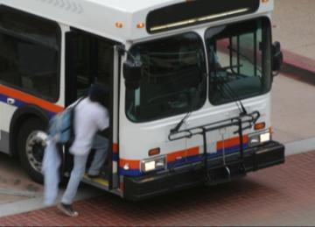

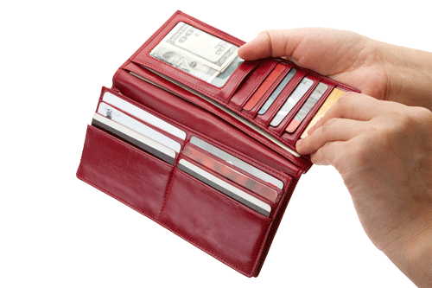



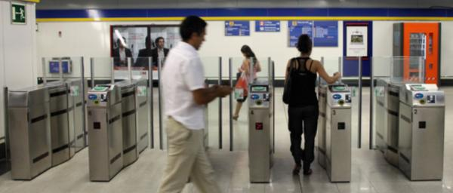
MasterCard Contactless and Transit
Less time
in transit
Less chance you’ll miss your ride
Less to worry about
Fewer cards in
your wallet
Tap & goTM to Ride
  A faster, simpler way to pay
  Easier transfers
  More convenient
  Available to all riders

Slide 8
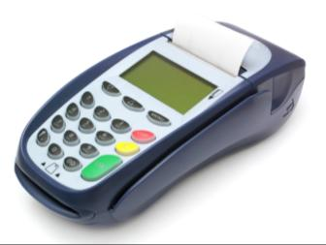

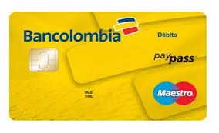



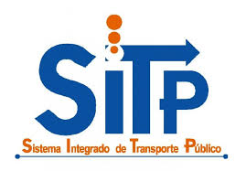


Recaudo Bogota Hybrid card solution: 2 cards in 1
Contactless
Payment App.
Credit or Debit
Transit Application
Recaudo Bogotá
One Card – One Chip – Two Applications

Slide 9

Multiple benefits for the issuer
Gain presence in transit world
Access to the retail world using contactless technology
Top of the wallet card
Increase usage and spend in retail
Maestro Transit
(Hybrid)
Highly technological product (differentiation)
Increase customers’ stickiness / Loyalty
Useful product valued by cardholders
Possible use of a sticker (in 2nd phase)

Slide 10
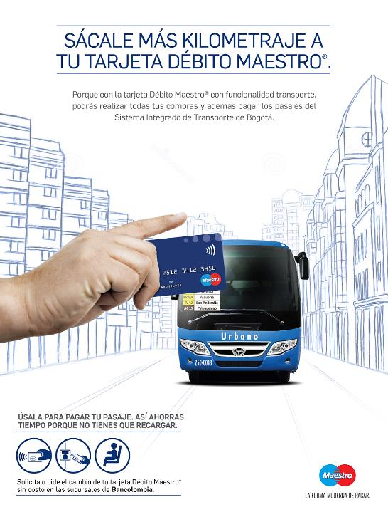
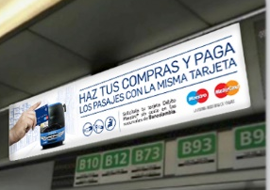
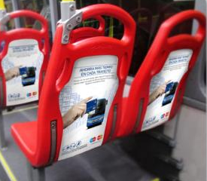
Communication
Notes:
REF. CARTERA
REF. HAMBURGUESA

Slide 11

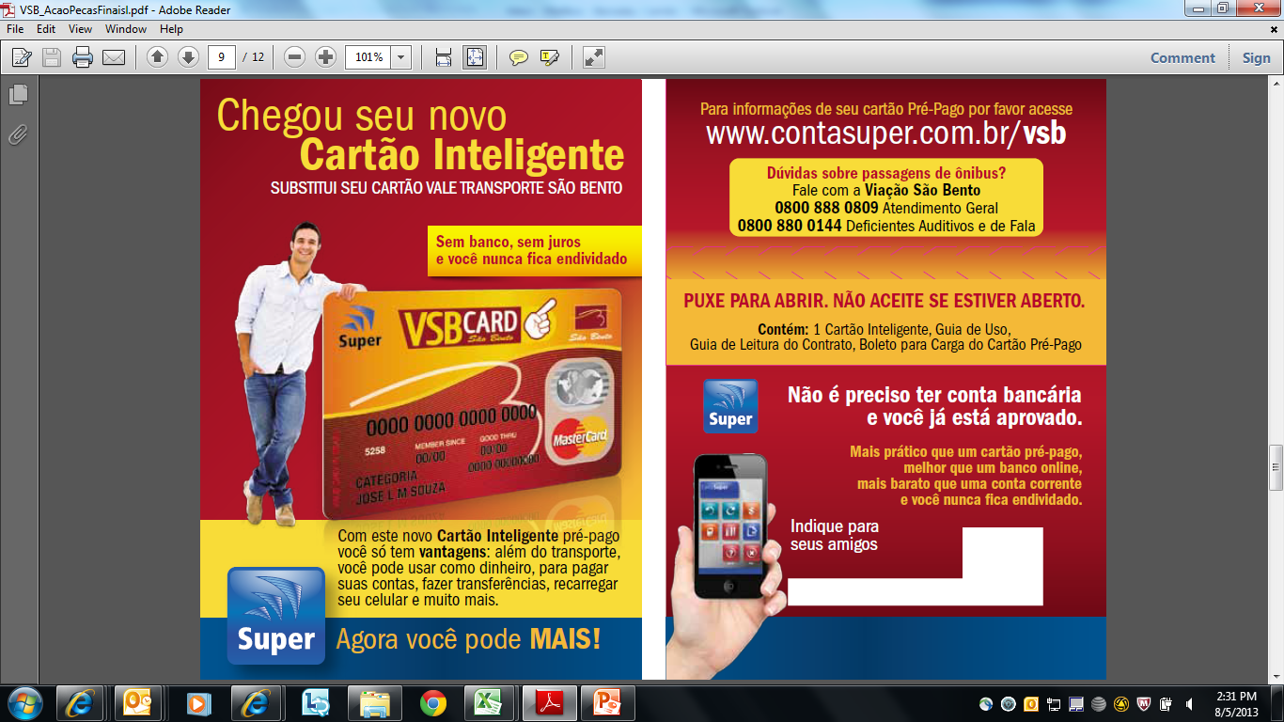
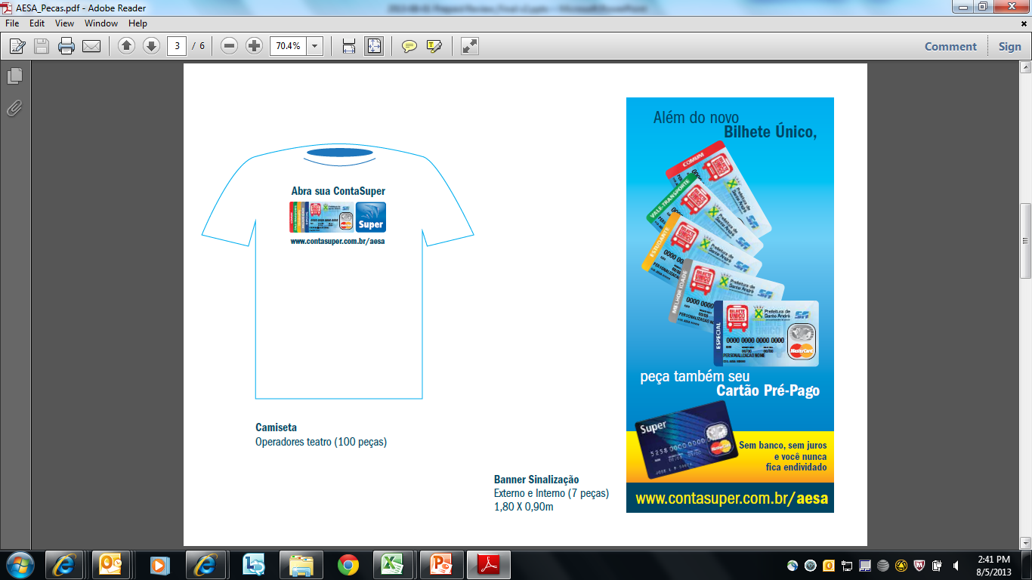
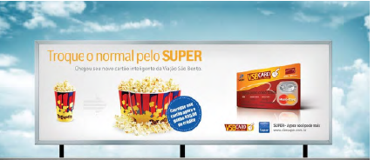
São Paulo – Transit initiatives
Cartão BOM
VSB

Slide 12

“Social Card” Concept
Split liabilities – Entitlement/Insurance Scheme vs Payment Scheme
Replaces existing paper-based schemes
Uses spare capacity on existing EMV infrastructure (cards & terminals) to securely check and apply social entitlement
Allows previously unbanked and under-banked citizens access to banking services
Reduces fraud, lowers costs, increases ease of use for service providers and end users
Reinforces existing trust relationship between banks and their customers
Social benefits and payment in a single transaction

Slide 13
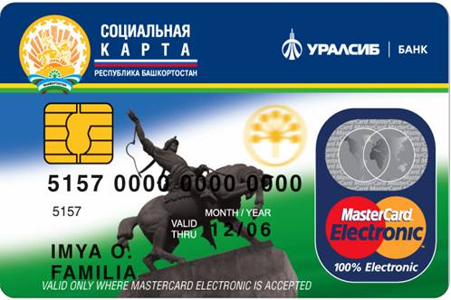

First EMV “Social Card” launched in Russia (2007)
Program Logo
Bank Logo
EMV chip:
– C/D Payment Application
– Program Information
Payment Brand Logo
First card to integrate an EMV-based payment application with social benefits program
  Medical Information, Transportation Benefits
  Pension Number, Taxpayer ID Number
  Employee Enrollment Number
The business case for banks is based primarily on recruiting unbanked / under-banked customers
The business case for governments is based on cost and fraud reduction

Slide 14


South African Social Security Agency Card (SASSA)
Context:
  SASSA (South African Social Security) manages the distribution of monthly social grants for more than 9.2M beneficiaries including:
  Fraud: illegal collection of subsidies, difficulties to verify if the beneficiary is still alive, duplication of children grants, etc
  High operational Costs
  Grants distributed in cash, lack of financial inclusion
Solution Implemented:
1 chip card with 2 applications
  UEPS (Universal Electronic Payment System): securely authenticates user (biometrics) and liberates grants monthly
  EMV Debit application – possibility for cardholder to use the grant in any EMV terminal or ATM. Promotes financial inclusion
Enrollment and card issuance
  Mobile enrollment kit for biometrics + card instant issuance

Slide 15
SASSA - Video

Slide 16


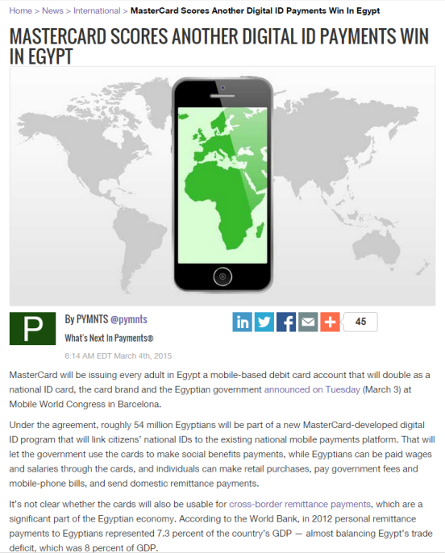
Egyptian Gov. and MasterCard collaborate to extend financial inclusion to 54M citizens
Notes:
Egyptian Government and MasterCard Collaborate to Extend Financial Inclusion to 54 Million Citizens through Digital National ID Program
The cooperation agreement between Ministry of Communications and Information Technology, Ministry of Finance, Egyptian Banking Corporation, and MasterCard is a landmark public/private partnership model
Partnership will enable 54 million Egyptians to contribute to the formal economy by linking their national ID to the national mobile ecosystem
To tweet this news, copy and paste http://news.mstr.cd/17BEWaO to your Twitter handle with the hashtags #MasterCard and #MWC15
Barcelona, March 3, 2015: The Government of Egypt, represented by the Ministry of Communications and Information Technology, and MasterCard today announced the details of a recent Memorandum of Understanding (MoU) that will aim to extend financial services to 54 million Egyptians. The announcement was made by H.E. Atef Helmy, Minister of Communications and Information Technology, and Ajay Banga, Chief Executive Officer of MasterCard, at the Mobile World Congress in Barcelona.
As part of the agreement, MasterCard will work with the government to roll out a digital ID program that links citizens’ national ID to the existing national mobile money platform, allowing Egyptians to participate in the formal electronic economy through a single, easy-to-use cashless program.
H.E. Atef Helmy, Minister of Communications and Information Technology, commented: “Under Egypt’s new progressive leadership, the country is on the road of positive change; we remain committed to driving this change. With Egypt’s mobile penetration rate at more than 100 per cent and an existing interoperable national mobile money platform, this collaboration with MasterCard will provide millions of Egyptians with access to an innovative, safe and simple way to conduct financial transactions using their national ID card.”
According to the Minister, knowledge transfer will play an important role in the partnership and MasterCard’s global experience and expertise will also be leveraged to boost innovation efforts and enhance citizen engagement. In addition, the two entities will work together build an innovation center in Cairo that will leverage MasterCard’s latest technologies and make them available in the market.
Ajay Banga, Chief Executive Officer, MasterCard, commented: “Financial inclusion is the foundation for economic growth that’s more inclusive, equitable, and sustainable. It is not only about how to better pay, and get paid, in situations where banking infrastructure is absent. It’s also about leveraging technology and access to resources so that communities can grow and achieve new things. We are proud and honored to announce this partnership with the Government of Egypt. We have a long and rich history with the country, and this partnership further highlights our commitment to Egypt and its future.”
MasterCard already has significant assets and partnerships in Egypt, and will leverage those to deploy the new cashless system. The system will allow the government to issue digital ID cards which can be used to pay for a number of services including government fees, mobile bills, merchant purchases and domestic remittances. In addition, salaries and social benefits will be electronically disbursed through the card. All transactions will be processed in real-time and will be fully secure.
Globally, the electronic distribution of payments has had a profound effect on increasing government efficiency and increasing transparency at the national level. As a technology company offering a wide range of payment technology, MasterCard has worked with governments around the world to deploy efficient and secure payment technology, resulting in significant savings and increased convenience.

Slide 17


Gracias por su atención
kim_hangoc@mastercard.com

